Slide 1

Sync+ 2.0
U625Timberline–Desay_EESE&CVPP parts
China EESE&CVPP
Updated on 2022-12-05
Desired Outcome
Awareness
Decision
Escalation Help
Think
Point of view
Plan to Implement
Implement

Slide 2
{R04 PRO HF4} Software overall status {Green}
Software key info
  Refer SWAD for the details:
    MCU version:20221017_537_PRO
    SOC version:20221124_0839_B3F27_R04.PRO.HF4
  Verification scope and method:
    {Full verification} executed with pass rate 97.99%, 0P1 and 11P2 issues found and not fixed. Refer test report for detail.
Main changes compared with previous version, refer RN for the details, highlights listed below:
    Release note– refer slide 3
    Open P2 issue list with risk evaluation – refer slide 4
    Performance status– refer slide 5-7
    OTA status– refer slide 8
    DID status-refer slide 9
Notes:
Add P1 weekly burn down chart

Slide 3
{R04 PRO HF4} Release note
序号 | 类型 | 描述
1 | bug fix | bug scope 修复合入
2 | HMI | 车模及内饰HMI更新
3 | APK | Ford与baidu APK合入

Slide 4

{R04 PRO HF4} Open P2 issue list with risk evaluation
Status | 计数
Analysis | 2
Verification | 9
总计 | 11
Note:
1.分析状态问题，预计在R05 pro发布前合入;
2.待验证问题，都将合入在R05 pro。
Notes:
Add P1 weekly burn down chart

Slide 5
{R04 PRO HF4} 性能测试状态
类别 | 序号 | 影响因素（新） | 权重 | R00 | R04 | CD542H R12 | R04 Target | 允许偏差上限 | 偏差 | 评分 | 得分 | 分析 | Test Result
响应时间 | 1 | Power on第一帧动画播放 | 1 | 9.22 | 8.84 | 8.83 | 9.5 | 10.5 | -6.97% | 4 | 4 |  | Pass
响应时间 | 2 | Power on到Fast RVC显示 | 1 | 9.22 | 8.92 | 8.97 | 9 | 10 | -0.85% | 4 | 4 |  | Pass
响应时间 | 3 | Power on Launcher界面可见 | 1 | 22.48 | 22.21 | 22.14 | 21 | 23.625 | 11.07% | 3 | 3 |  | Pass
响应时间 | 4 | Launcher显示到优先蓝牙重连完成 | 1 | 7.75 | 5.60 | 6.54 | 10 | 10.5 | -44.05% | 5 | 5 |  | Pass
响应时间 | 5 | Launcher显示到蓝牙音乐首次启动 | 1 | 1.42 | 1.81 | 1.54 | 2 | 2.4 | -9.35% | 4 | 4 |  | Pass
响应时间 | 6 | Launcher显示到FM首次启动 | 1 | 1.24 | 1.32 | 1.50 | 2 | 2.4 | -34.25% | 5 | 5 |  | Pass
响应时间 | 7 | Launcher显示到车机网络时间同步完成 | 0.5 | 11.13 | 11.57 | 18.48 | 18.75 | 22.5 | -38.30% | 5 | 2.5 |  | Pass
响应时间 | 8 | Power on开机动画过程中到Fast RVC显示 | 1 | 1.61 | 1.21 | 1.54 | 1.5 | 1.8 | -19.62% | 5 | 5 |  | Pass
响应时间 | 9 | Launcher显示到Fast RVC显示 | 2 | 1.84 | 1.30 | 1.60 | 1.5 | 1.8 | -13.09% | 4 | 8 |  | Pass
响应时间 | 10 | Launcher显示到优先设备BT音源恢复 | 1 | 14.05 | 6.81 | 7.03 | 10 | 10.5 | -31.94% | 5 | 5 |  | Pass
响应时间 | 11 | Launcher显示到FM音源恢复 | 1.5 |  | 0.91 |  | 2.4 | 2.88 | -62.10% | 5 | 7.5 |  | Pass
响应时间 | 12 | Launcher显示到车辆设置界面打开 | 0.5 | 3.37 | 2.67 | 2.30 | 2.2 | 2.64 | 21.30% | 2 | 1 |  | Pass
响应时间 | 13 | Launcher显示到空调设置界面打开 | 0.5 | 0.78 | 0.96 | 0.27 | 2 | 2.4 | -51.85% | 5 | 2.5 |  | Pass
响应时间 | 14 | Launcher显示到快捷菜单上点击空调按钮可用 | 0.5 | 1.43 | 1.47 | 0.39 | 1.5 | 1.8 | -1.82% | 4 | 2 |  | Pass
响应时间 | 15 | Launcher显示到SDM可用 | 0.5 | 3.37 | 3.27 | 5.76 | 7.2 | 8.2 | -54.65% | 5 | 2.5 |  | Pass
响应时间 | 16 | SDM硬按键切换成功 | 0.5 | 1.02 | 1.17 | 1.4 | 2.5 | 3 | -53.23% | 5 | 2.5 |  | Pass
响应时间 | 17 | Launcher显示到进入稳定运行阶段经过的时间 | 2 | 38.9 | 31.33 | 29.07 | 50 | 52.5 | -37.34% | 5 | 10 |  | Pass
响应时间 | 18 | 系统稳定状态下Setting首次启动 | 0.5 | 1.40 | 0.83 | 0.98 | 1.4 | 1.68 | -40.45% | 5 | 2.5 |  | Pass
响应时间 | 19 | 系统稳定状态下蓝牙音乐首次启动 | 1 | 1.77 | 1.41 | 1.59 | 2 | 2.4 | -29.47% | 5 | 5 |  | Pass
Notes:
Add P1 weekly burn down chart

Slide 6
{R04 PRO HF4} 性能测试状态
类别 | 序号 | 影响因素（新） | 权重 | R00 | R04 | CD542H R12 | R04 Target | 允许偏差上限 | 偏差 | 评分 | 得分 | 分析 | Test Result
响应时间 | 21 | 系统稳定状态下FM首次启动 | 1 | 1.12 | 0.79 | 1.02 | 1 | 1.2 | -21.17% | 5 | 5 |  | Pass
响应时间 | 22 | 稳定状态下Launcher热启动 | 1 |  | 0.32 | 0.39 | 0.625 | 0.75 | -48.85% | 5 | 5 |  | Pass
响应时间 | 23 | 稳定状态下设置二级菜单切换速度 | 1 |  | 0.58 | 0.782 | 0.625 | 0.75 | -7.40% | 4 | 4 |  | Pass
响应时间 | 24 | Setting热启动 | 1 | 0.56 | 0.66 | 0.39 | 0.7 | 0.91 | -5.17% | 4 | 4 |  | Pass
响应时间 | 25 | 蓝牙音乐热启动 | 1 | 0.55 | 0.75 | 0.59 | 0.65 | 0.845 | 15.02% | 3 | 3 |  | Pass
响应时间 | 26 | FM热启动 | 1 | 0.36 | 0.14 | 0.27 | 0.5 | 0.65 | -72.13% | 5 | 5 |  | Pass
响应时间 | 27 | 稳定状态下主题切换 | 0.5 |  | 1.02 | 0.84 | 1 | 1.2 | 1.63% | 4 | 2 |  | Pass
响应时间 | 28 | air conditioner热启动时间 | 0.5 | 0.22 | 0.32 | 0.23 | 0.50 | 0.65 | -36.93% | 5 | 2.5 |  | Pass
响应时间 | 29 | 蓝牙电话开机恢复通话界面 | 0.5 | 7.27 | 6.18 | 6.36 | 10.00 | 10.50 | -38.20% | 5 | 2.5 |  | Pass
响应时间 | 30 | 蓝牙电话冷启动时间 | 1 | 1.24 | 1.11 | 1.41 | 2.00 | 2.40 | -44.47% | 5 | 5 |  | Pass
响应时间 | 31 | 蓝牙电话热启动时间 | 0.5 | 0.3 | 0.26 | 0.34 | 0.50 | 0.65 | -47.84% | 5 | 2.5 |  | Pass
响应时间 | 32 | 投屏冷启动时间 | 0.5 | 1.18 | 0.52 | 0.64 | 1.00 | 1.20 | -48.47% | 5 | 2.5 |  | Pass
响应时间 | 33 | 精简屏幕冷启动时间 | 0.5 | NT | 1.19 | 1.20 | 1.50 | 1.80 | -20.98% | 5 | 2.5 |  | Pass
响应时间 | 34 | 精简屏幕热启动时间 | 0.5 | NT | 0.56 | 0.76 | 1.30 | 1.56 | -57.23% | 5 | 2.5 |  | Pass

Slide 7
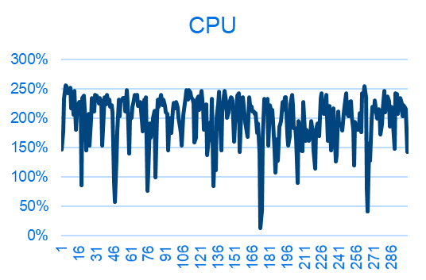
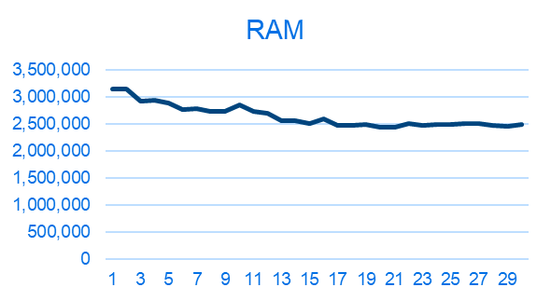
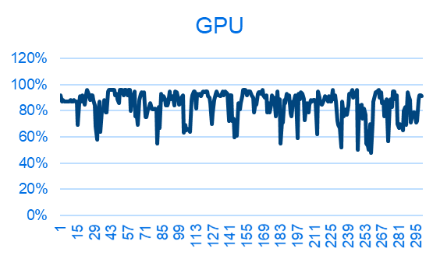
{R04 PRO HF4} 性能状态
序号 | 影响因素 | 权重 | R04 | 结果 | 分析
1 | 8小时Monkey测试-设置 | 0.5
2 | 8小时Monkey测试-蓝牙音乐 | 0.5 | com.desay.setting 内存泄漏 | Fail | Cause Analysis：dialog没有销毁持有上下文 R05优化修复
3 | 8小时Monkey测试-蓝牙电话 | 0.5
4 | 8小时Monkey测试（其他所属应用） | 0.5
5 | 24小时Monkey中的ANR次数 | 1 | 2 | Fail | com.ford.sync.relaxmode,com.desay.setting ANR Cause Analysis：weakrefrence持有的对象没有那么迅速被回收,R05 优化改善
6 | 24小时Monkey中的Crash次数 | 1 | 0
7 | 24小时Monkey中内存泄露进程数 | 1 | 0
CPU Free
RAM Free
GPU Free
Notes:
Add P1 weekly burn down chart

Slide 8
{R04 PRO HF4} OTA测试状态
Title: | Verification Test Report For OTA
Function Name | Total Test Case | Passed Test Case | Failed Test Case | Percentage of Test Completion: | Test Cases Pass Percentage:
TC_SOC_OTA | 87 | 82 | 0 | 94.25% | 100.00%
TC_MCU_OTA | 78 | 76 | 0 | 97.44% | 100.00%
TC_MCU_USB | 66 | 64 | 1 | 98.48% | 98.46%
TC_SOC_USB | 68 | 66 | 0 | 97.06% | 100.00%
Total | 299 | 288 | 1 | 96.66% | 99.65%
Test Summary Description
主要问题 JIRA ID:AW2-10482 USB MCU升级之后USB设备内没有vil文件
R04 PRO HF4 版本冒烟测试结果Pass
Notes:
Add P1 weekly burn down chart

Slide 9
{R04 PRO HF4} DID 测试状态
P2AT-18D668-MB DID test status
| DID | EXPECTED #PART | RECEIVED #PART | RESULT |
============================================================
| F113 | P2AT-18D668-MB | P2AT-18D668-MA | Failed |
------------------------------------------------------------
| F111 | P2AT-14H370-MA | P2AT-14H370-MA | Passed |
------------------------------------------------------------
| F188 | P2AT-14H361-AB | P2AT-14H361-AB | Passed |
------------------------------------------------------------
| F10A | ~N2AT-14H369-AB | ~N2AT-14H369-AB | Passed |
------------------------------------------------------------
| F16B | P2AT-14H375-AA | P2AT-14H375-AA | Passed |
------------------------------------------------------------
| 8033 | P2AT-14H379-AB | P2AT-14H379-AB | Passed |
------------------------------------------------------------
| F180 | MB6T-14H368-AD | MB6T-14H368-AD | Passed |
------------------------------------------------------------
| F110 | DSMB6T-18D668-AG | DSMB6T-18D668-AG | Passed |
------------------------------------------------------------
| F163 | 5 | 5 | Passed |
------------------------------------------------------------
| F162 | 7 | 7 | Passed |
------------------------------------------------------------
P2AT-18D668-PB DID test status
| DID | EXPECTED #PART | RECEIVED #PART | RESULT |
==============================================================
| F113 | P2AT-18D668-PB | P2AT-18D668-PA | Failed |
--------------------------------------------------------------
| F111 | P2AT-14H370-PA | P2AT-14H370-PA | Passed |
--------------------------------------------------------------
| F188 | P2AT-14H361-AB | P2AT-14H361-AB | Passed |
--------------------------------------------------------------
| F10A | ~N2AT-14H369-AB | ~N2AT-14H369-AB | Passed |
--------------------------------------------------------------
| F16B | P2AT-14H375-AA | P2AT-14H375-AA | Passed |
--------------------------------------------------------------
| 8033 | P2AT-14H379-AB | P2AT-14H379-AB | Passed |
--------------------------------------------------------------
| F180 | MB6T-14H368-AD | MB6T-14H368-AD | Passed |
--------------------------------------------------------------
| F110 | DSMB6T-18D668-AG | DSMB6T-18D668-AG | Passed |
--------------------------------------------------------------
| F163 | 5 | 5 | Passed |
--------------------------------------------------------------
| F162 | 7 | 7 | Passed |
--------------------------------------------------------------
    Note :F113 Failed---为旧样机硬件烧录标定，刷软件时无法更新

